Slide 1
SYNONYMS, AND SEQUENCES

Slide 2
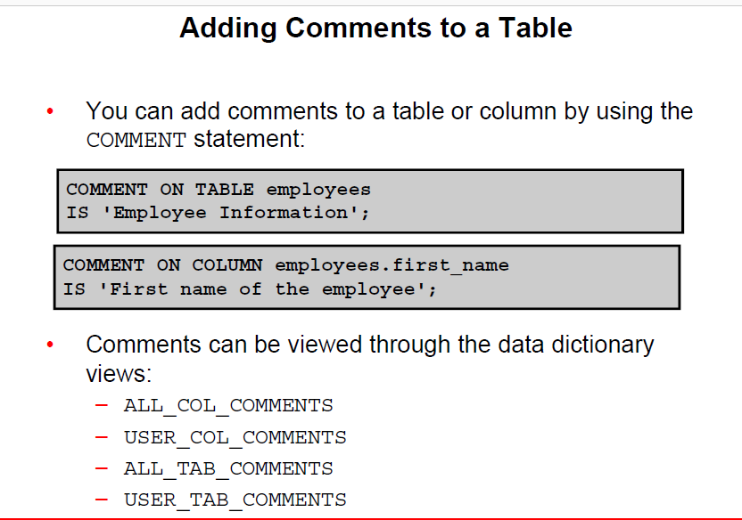
Bordoloi and Bock

Slide 3
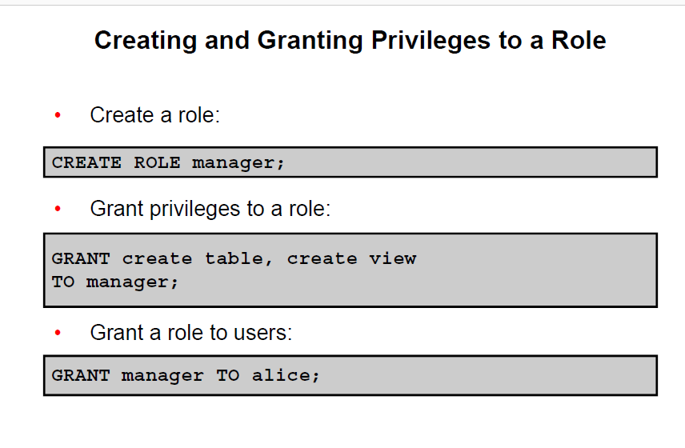
Bordoloi and Bock

Slide 4
SYNONYMS
        A synonym is an alias, that is, a form of shorthand used to simplify the task of referencing a database object.
        Creating Synonyms
        The general form of the CREATE SYNONYM command is:
        CREATE [PUBLIC] SYNONYM synonym_name FOR object_name;
Bordoloi and Bock

Slide 5
SYNONYMS
        There are two categories of synonyms, public and private.
        A public synonym can be accessed by any system user.
        The individual creating a public synonym does not own the synonym – rather, it will belong to the PUBLIC user group that exists within Oracle.
        Private synonyms, on the other hand, belong to the system user that creates them and reside in that user's schema.
Bordoloi and Bock

Slide 6
SYNONYMS
        A system user can grant the privilege to use private synonyms that they own to other system users.
        In order to create synonyms, you will need to have the CREATE SYNONYM privilege.
        This privilege will be granted to you by the DBA.
        You must have the CREATE PUBLIC SYNONYM privilege in order to create public synonyms.
Bordoloi and Bock

Slide 7
SYNONYMS
        The three advantages to synonym usage.
        • First, a synonym provides what is termed location transparency because the synonym name hides the actual object name and object owner from the user of the synonym.
        • Second, you can create a synonym for a database object and then refer to the synonym in application code. The underlying object can be moved or renamed, and a redefinition of the synonym will allow the application code to continue to execute without errors.
        • Third, a public synonym can be used to allow easy access to an object for all system users.
Bordoloi and Bock

Slide 8
Dropping Synonyms
        If you own a synonym, you have the right to drop (delete) the synonym. The DROP SYNONYM command is quite simple.
        DROP SYNONYM synonym_name;
        In order to drop a public synonym you must include the PUBLIC keyword in the DROP SYNONYM command.
        In order to drop a public synonym, you must have the DROP PUBLIC SYNONYM privilege.
        DROP PUBLIC SYNONYM synonym_name;
Bordoloi and Bock

Slide 9
Renaming Synonyms
        Private synonyms can be renamed with the RENAME SYNONYM command.
        All existing references to the synonym are automatically updated.
        Any system user with privileges to use a synonym will retain those privileges if the synonym name is changed.
        The syntax of the RENAME SYNONYM command is like that for the RENAME command for any other database object such as a view or table.
        RENAME old_synonym_name TO new_synonym_name;
Bordoloi and Bock

Slide 10
Renaming Synonyms
        The RENAME SYNONYM command only works for private synonyms.
        If we attempt to rename a public synonym such as the tblspaces synonym, Oracle will return an ORA-04043: object tblspaces does not exist error message as is shown here.
        RENAME tblspaces TO ts;
        ORA-04043: object TBLSPACES does not exist
Bordoloi and Bock

Slide 11
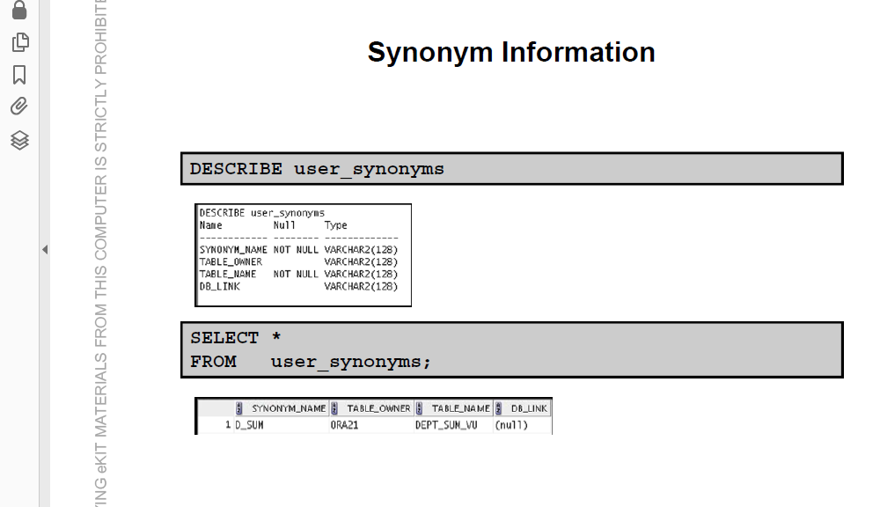
Bordoloi and Bock

Slide 12
SEQUENCES
        Oracle provides the capability to generate sequences of unique numbers, and they are called sequences.
        Just like tables, views, indexes, and synonyms, a sequence is a type of database object.
        Sequences are used to generate unique, sequential integer values that are used as primary key values in database tables.
        The sequence of numbers can be generated in either ascending or descending order.
Bordoloi and Bock

Slide 13
Creating Sequences
        The syntax of the CREATE SEQUENCE command is fairly complex because it has numerous optional clauses.
        CREATE SEQUENCE <sequence name>
        [INCREMENT BY <number>]
        [START WITH <start value number>]
        [MAXVALUE <MAXIMUM VLAUE NUMBER>][NOMAXVALUE]
        MINVALUE <minimum value number>][NOMINVALUE]
        [CYCLE] [NOCYCLE]
        [CACHE <number of sequence value to cache>][NOCACHE]
        [ORDER] [NOORDER];
        Increment default is one , no zero , +ve/-ve (asc/desc)
        Max value equal to start or greater than start and min values.
        Min value equlal to start or less than max.
        Cache no of int value keep in memory. Default cache is 20
        No cycle means not sequence generate more than max value.
Bordoloi and Bock

Slide 14
Example
        CREATE SEQUENCE order_number_sequence
        INCREMENT BY 1
        START WITH 1
        MAXVALUE 100000000
        MINVALUE 1
        CYCLE
        CACHE 10;
        Sequence created.
Bordoloi and Bock

Slide 15
Accessing Sequence Values
        Sequence values are generated through the use of two pseudocolumns named currval and nextval.
        A pseudocolumn behaves like a table column, but psuedocolumns are not actually stored in a table.
        We can select values from pseudocolumns but cannot perform manipulations on their values.
        The first time you select the nextval pseudocolumn, the initial value in the sequence is returned.
        Subsequent selections of the nextval pseudocolumn will cause the sequence to increment as specified by the INCREMENT BY clause and will return the newly generated sequence value.
Bordoloi and Bock

Slide 16
Accessing Sequence Values
        The currval pseudocolumn returns the current value of the sequence, which is the value returned by the last reference to nextval.
        Example
        CREATE TABLE sales_order (
        order_number NUMBER(9)
        CONSTRAINT pk_sales_order PRIMARY KEY,
        order_amount NUMBER(9,2));
Bordoloi and Bock

Slide 17
Accessing Sequence Values
        The INSERT commands shown below insert three rows into the sales_order table. The INSERT commands reference the order_number_sequence.nextval pseudocolumn.
        INSERT INTO sales_order
        VALUES(order_number_sequence.nextval, 155.59 );
        INSERT INTO sales_order
        VALUES(order_number_sequence.nextval, 450.00 );
        INSERT INTO sales_order
        VALUES(order_number_sequence.nextval, 16.95);
Bordoloi and Bock

Slide 18
Accessing Sequence Values
        SELECT *
        FROM sales_order;
        ORDER_NUMBER ORDER_AMOUNT
        ------------ ------------
        1 155.59
        2 450
        3 16.95
Bordoloi and Bock

Slide 19
Accessing Sequence Values
        Use of currval.
        CREATE TABLE order_details (
        order_number NUMBER(9),
        order_row NUMBER(3),
        product_desc VARCHAR2(15),
        quantity_ordered NUMBER(3),
        product_price NUMBER(9,2),
        CONSTRAINT pk_order_details
        PRIMARY KEY (order_number, order_row),
        CONSTRAINT fk_order_number FOREIGN KEY (order_number) REFERENCES sales_order);
Bordoloi and Bock

Slide 20
Accessing Sequence Values
        The order_details table has a FOREIGN KEY reference to the sales_order table through the order_number column.
        DELETE FROM sales_order;
        INSERT INTO sales_order
        VALUES ( order_number_sequence.nextval, 200.00 );
        INSERT INTO order_details
        VALUES ( order_number_sequence.currval, 1, 'End Table',1, 100.00);
        INSERT INTO order_details
        VALUES ( order_number_sequence.currval, 2, 'Table Lamp',2, 50.00);
Bordoloi and Bock

Slide 21
Accessing Sequence Values
        SELECT *
        FROM sales_order;
        ORDER_NUMBER ORDER_AMOUNT
        ------------ ------------
        5 200
        SELECT *
        FROM order_details;
        ORDER_NUMBER ORDER_ROW PRODUCT_DESC QUANTITY_ORDERED PRODUCT_PRICE
        --------- -------- ---------- ------------- ---------- 5 1 End Table 1 100
        5 2 Table Lamp 2 50
Bordoloi and Bock

Slide 22
Altering a Sequence
        A sequence is usually altered when it is desirable to set or eliminate the values of the MINVALUE or MAXVALUE parameters, or to change the INCREMENT BY value, or to change the number of cached sequence numbers.
        The ALTER SEQUENCE command shown here changes the MAXVALUE of the order_number_sequence to 200,000,000.
        ALTER SEQUENCE order_number_sequence MAXVALUE 200000000;
        Sequence altered.
Bordoloi and Bock

Slide 23
Altering a Sequence
        When specifying a MINVALUE clause, the specified value should be less than the MAXVALUE where a sequence generates ascending numbers.
        In the case of a descending sequence, the MAXVALUE should be less than the MINVALUE.
Bordoloi and Bock

Slide 24
Viewing Sequence Properties
        You may need to review the names and properties of your sequences.
        You can do this by querying the USER_SEQUENCES system view with a SELECT command.This view is part of the database's data dictionary.
        SELECT * FROM USER_SEQUENCES;
        SEQUENCE_NAME MIN_VAL MAX_VALUE INCRE C O CACHE_SIZE Last_N
        ---------------- ------ ---------- ----- -- -- -------- -----
        ORDER_NUMBER_SEQUENCE 1 200000000 1 Y N 10 6
Bordoloi and Bock

Slide 25
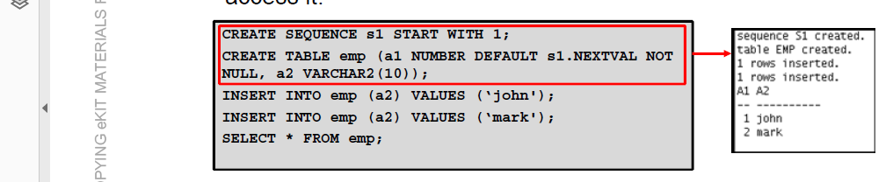
Bordoloi and Bock

Slide 26
Dropping a Sequence
        DROP SEQUENCE command is used to drop sequences that need to be recreated or are no longer needed.
        The general format is shown here along with an example that drops the order_number_sequence object.
        DROP SEQUENCE <sequence name>;
        DROP SEQUENCE order_number_sequence;
        Sequence dropped.
Bordoloi and Bock

Slide 27
create sequence ser increment by 2
start with 1
maxvalue 10
minvalue 1
cycle
nocache
order ;
create table ang(rno int);
select ser.nextval from dual;
select ser.nextval from dual;
insert into ang values(ser.nextval);
select * from ang;
select ser.currval from ang;
alter sequence ser maxvalue 20;
Bordoloi and Bock

Slide 28

END
Bordoloi and Bock

